Slide 1

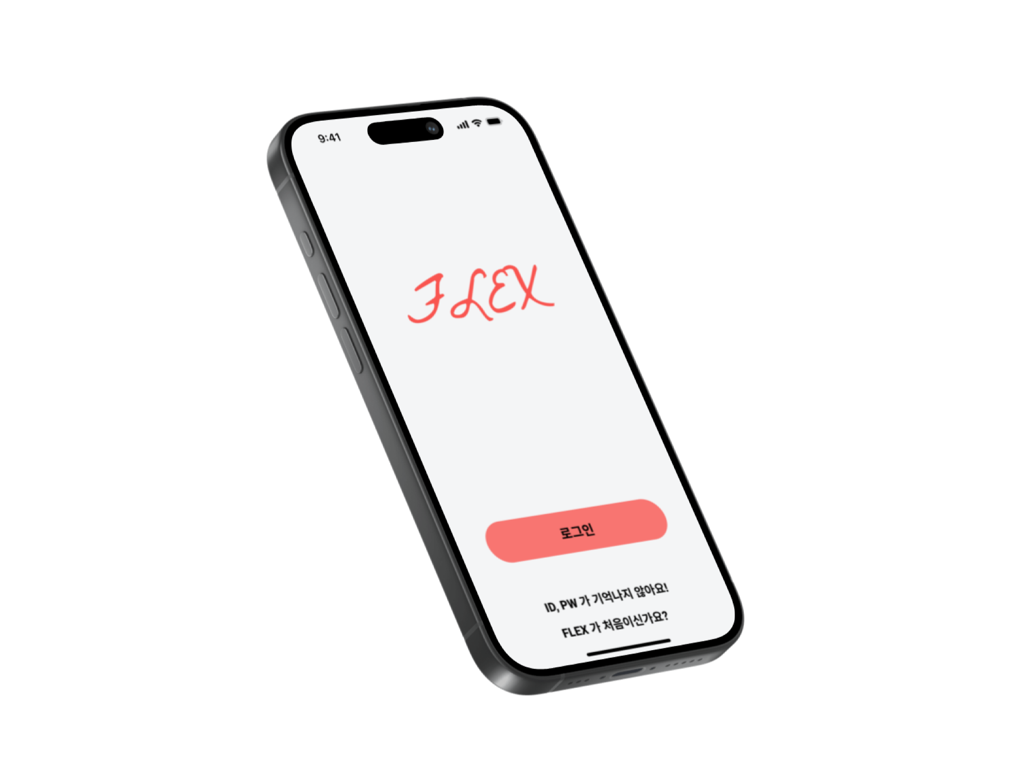








FLEX
Your own Food & health assistant

Slide 2
TABLE OF CONTENTS
01
02
03
04
05
Background
Problem statement
Proposed approach / solution
Tech background
Planning with Role assignment

Slide 3
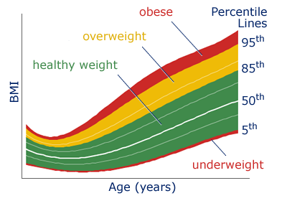
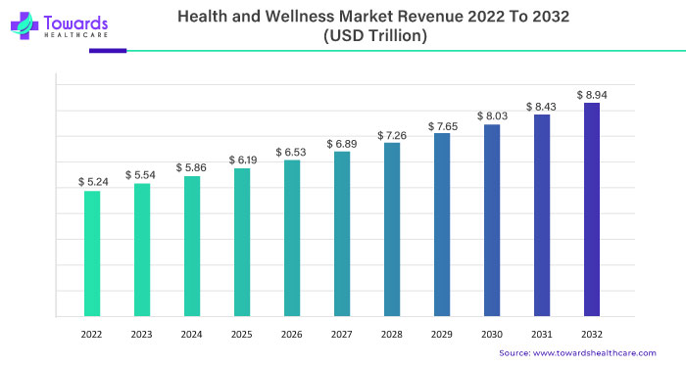
Background
The obesity rate is gradually increasing around the world.
Accordingly, the health-related market is gradually growing.
https://www.bcm.edu/bodycomplab/Flashapps/bmiVAgeChartpage.html
https://www.towardshealthcare.com/insights/health-and-wellness-market-exploring-the-self-care

Slide 4
Problem statement
Existing health management programs fail to account for individuals' fitness levels and dietary preferences.
So we focus on Individual characteristics

Slide 5
Proposed approach
Our goal
Recommend desired meal menus by utilizing the user's personal preferences and exercise data
Our input
2-1. user-written preferences and details about today's workout.
2-2. the user's physical information
Our output
a single recommended food menu item
.

Slide 6
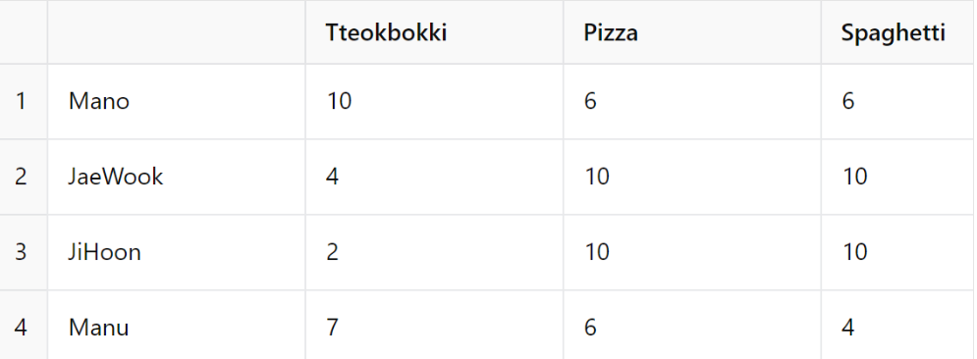
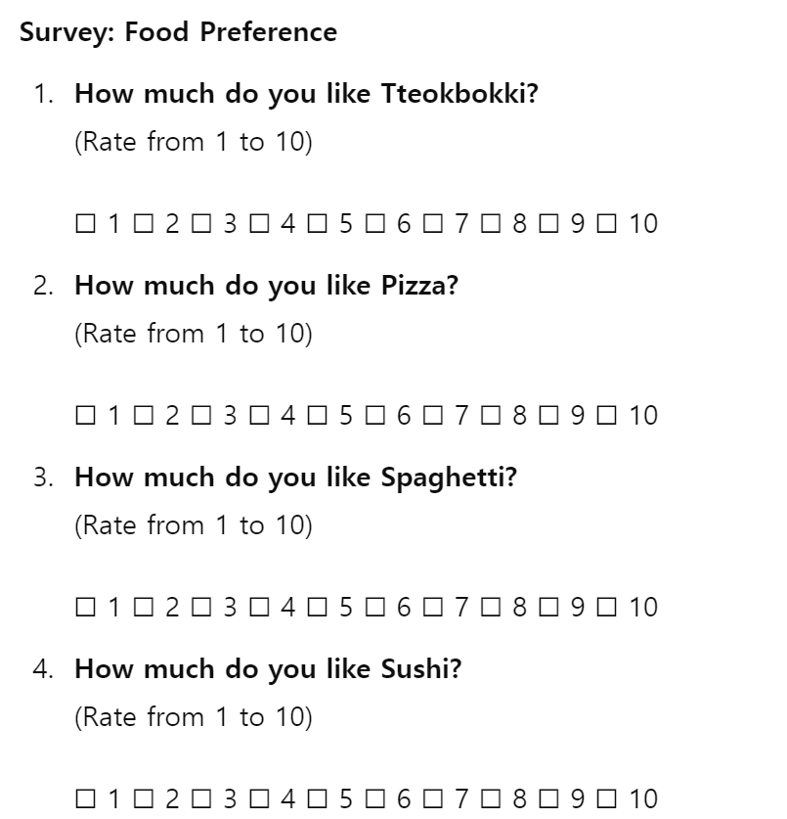
Proposed Solution
1. Feature selection
Out of thousands of available foods, the project will select specific items to be utilized.
2. Database development
The database will be constructed by evaluating preference scores for the selected features from all participants
3. New user
When a new user joins, they will be asked to rate their preferences for 10 different food items.

Slide 7
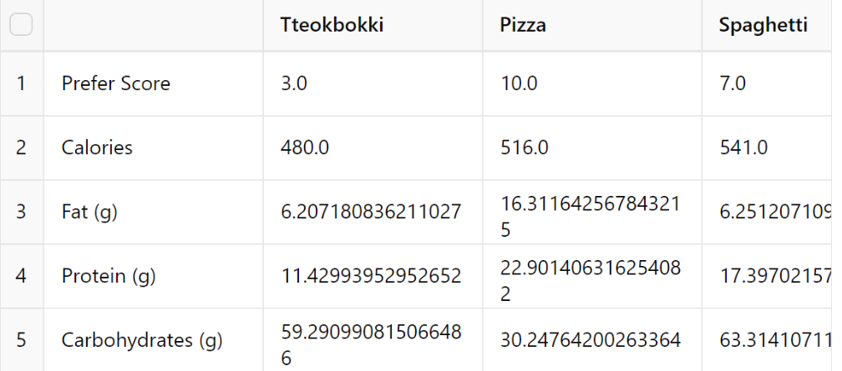
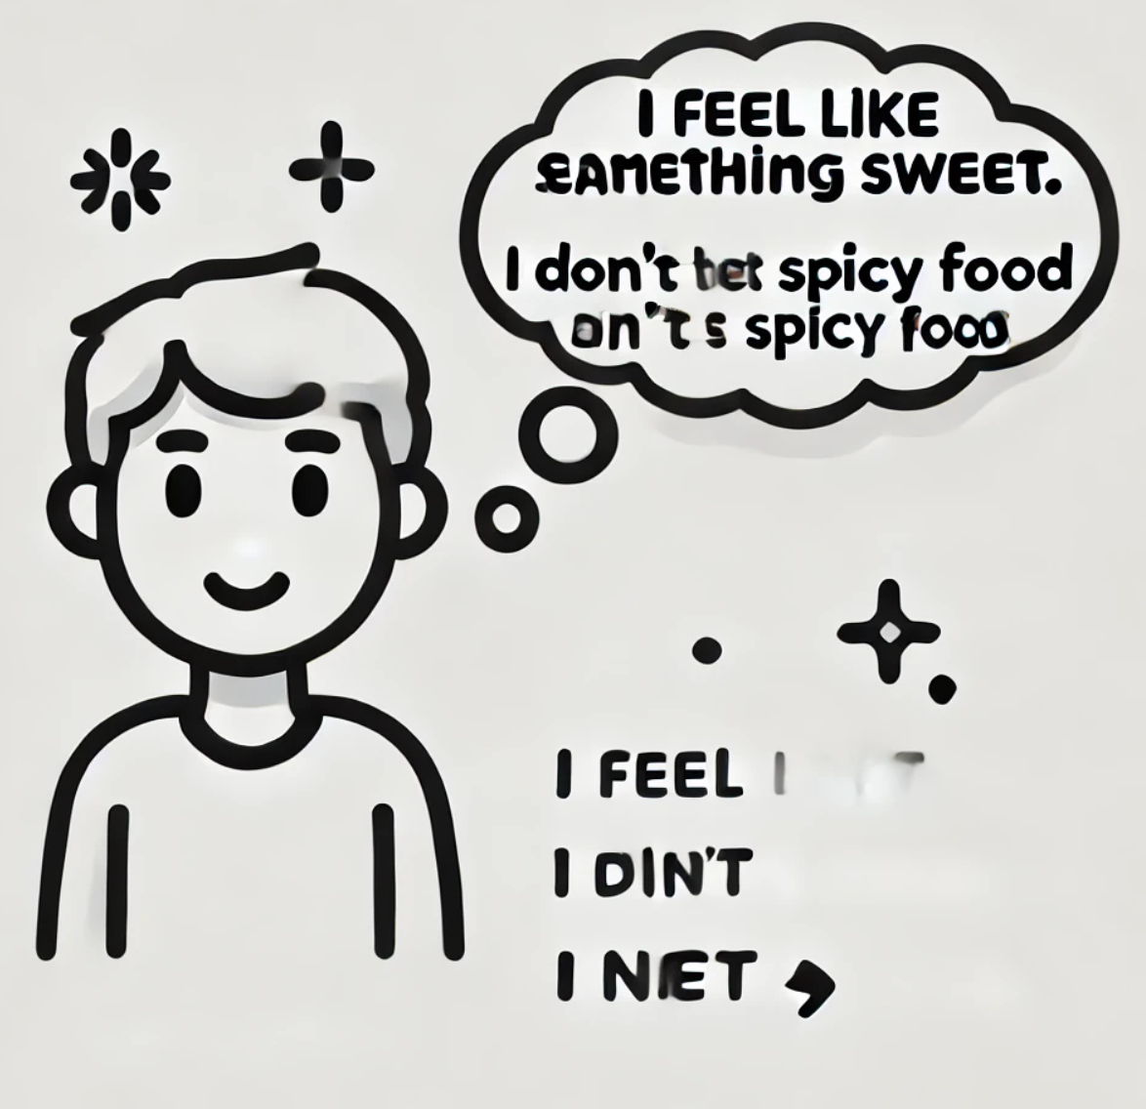
Proposed Solution
4. Find Similar user
Based on the user's preferences for the 10 selected features, the system will identify the most similar user from the database.
5. NLP Model
Based on the new user's written responses in 2-1, the system will analyze their preferred or disliked foods and tastes. This analysis will be used to assign bonus points to the data
6. Call Food API
The system will call a food API to retrieve nutritional information and other relevant details for each food item. This data will then be stored in the database

Slide 8
Proposed Solution
7. MLP Model The MLP model calculates the user's daily recommended intake using data from 2-2. This intake is split across meals, and the amounts are subtracted from sequences generated in step 6.
8. NLP Model The system analyzes the workout routine using data from 2-2, calls an exercise API to calculate calories burned, and subtracts this from the sequences generated in step 7.
9. Output Extraction
9-1 Similarity Distance Calculation
9-2 Reinforcement Learning: Applied for optimizing the recommendation process.

Slide 9
Proposed Solution
10. FeedBack
The user assigns a new preference score to the selected food, and this score is reflected in the database. Additionally, a small weight is added to foods that were not consumed, and a small weight is subtracted for foods that were consumed.

Slide 10

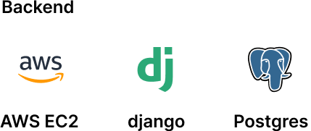
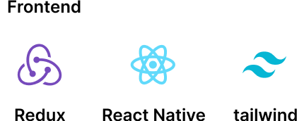
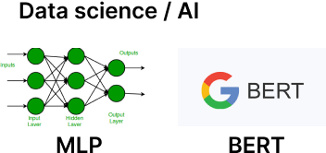
Tech background

Slide 11
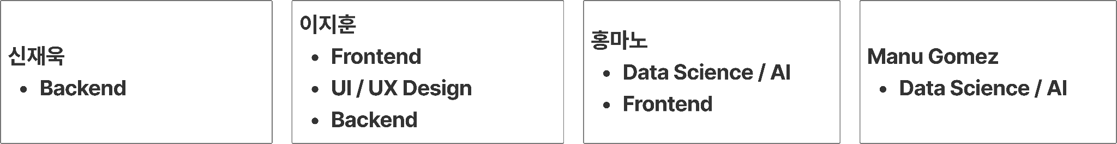
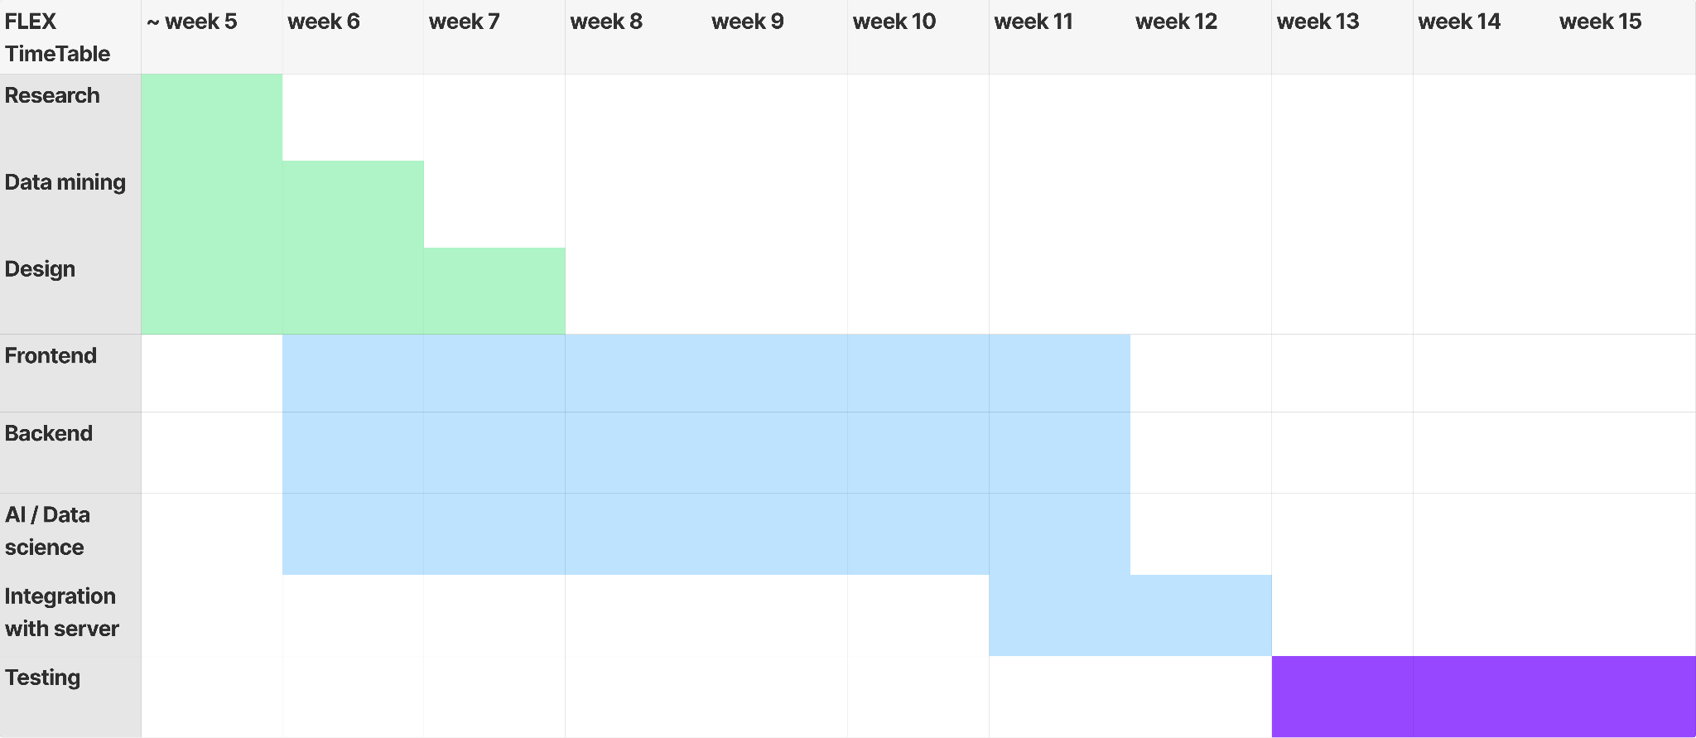
Planning & Roles

Slide 12
THANK YOU

